Slide 1
Stress and your brain
Brooke Farnsworth
School Counsellor

Slide 2
Stressful?

Slide 3
What is stress?
Bodily response to a stressor
Can be brought on by a thought or a memory
Can be emotional or physical stress
Can enhance or diminish performance*
Not always bad –
stress can be helpful at times
A normal reaction!
Can become a problem if present after stressor is gone…

Slide 5
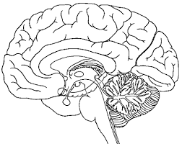
What is happening in our brain?

Slide 6
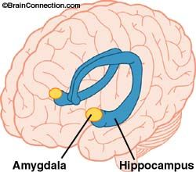
What is happening in our brain?
Amygdala
* Plays a central role in our emotional responses
* Engages in response to input, can lead to fight or flight behaviour. Gives us a clear message!
* Fearful experiences take fewer repetitions to stick
* Experiences with a strong emotional or survival base lead to more likely involvement of amygdala
Hippocampus
* Input from senses
* Memories are sorted and filed into long term storage
* Have I dealt with this stressor before?
* How should I react?

Slide 7
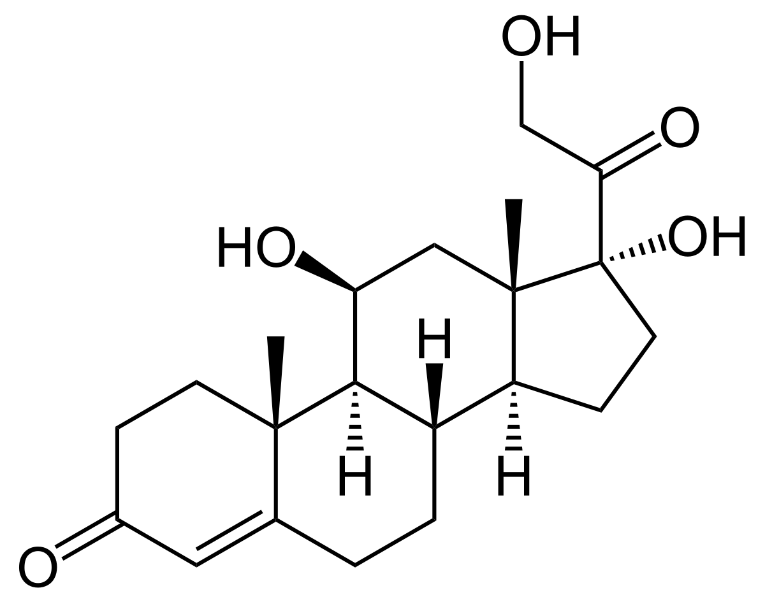
What is happening in our brain?
As our body perceives stress a hormone called cortisol is released. Cortisol helps to increase our heart rate and slow non-essential processes such as digestion. Cortisol works with glucose to enable to fight or flight response.
Some people live in this heightened state much of the time (especially when assessments or exams are due). Ongoing stressors such as conflict, accommodation instability, personality, previous maltreatment or abuse.
Ongoing excess cortisol exposure can have both short and long term effects on the body.

Slide 8
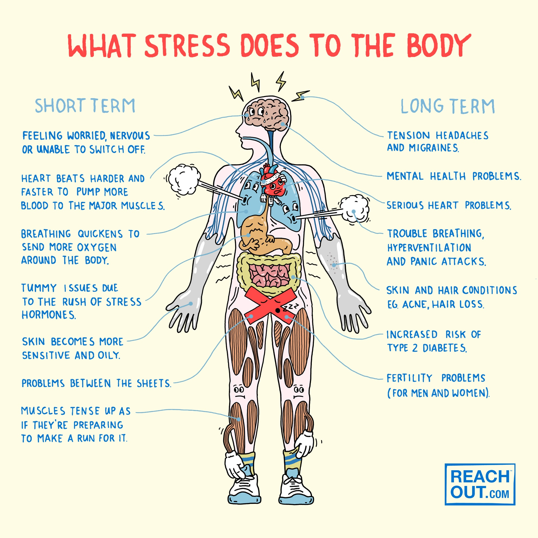

Slide 9
We all have different triggers and levels of resilience.
Which of these would make you feel stress or anxiety?
A big dog blocking your path

Slide 10
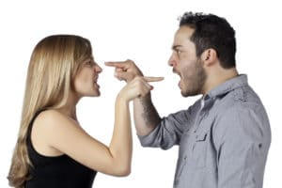
Conflict

Slide 11
Study stress

Slide 12
Walking into a crowded room

Slide 13
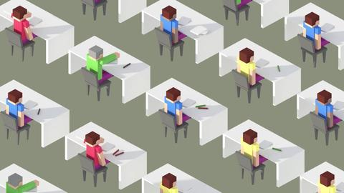
Exams

Slide 14
We all experience and react to stress differently!
thoughts
feelings
behaviour
I haven’t studied hard enough
Shame and embarrassment
Netflix as a distractor

Slide 15
We all experience and react to stress differently!
thoughts
feelings
behaviour
I haven’t studied hard enough
Gettin’ it done!
*then reward yourself with Netflix
Hope and relief
I’ll start now

Slide 16
Unhealthy coping strategies
Healthy coping strategies
Talking about your problem
Shutting down/withdrawing
Overthinking
Thinking about what has worked in the past
Drug or alcohol use
Using social support
Self harm
Trying relaxation strategies

Slide 17
Psych tips!
What’s the issue? – is what you’re stressing about what you are actually stressing about? It could be one big thing or lots of little things. If nothing obvious comes to mind, talk to someone you can trust. Outsiders often have more insight because they aren’t as emotionally involved
Can you do anything to change it? – once you have worked out what is stressing you it’s time to think realistically about the problem. Is there anything you can do about it?
If the answer is yes, what can you do? – if you feel you have some control over the situation you can use some problem-solving skills to help reduce the amount of stress it is causing you. E.g. an upcoming exam is stressing you out. What can you do?
If the answer is no, what can you do to feel better about it? – if the situation is out of your control then trying to change it will only increase your stress. In this case it’s better to try and change aspects you do have control over such as your self-talk, how you think about the situation and what you can learn from it

Slide 18
Place your screenshot here

Slide 19
Take aways…
Stress can be both beneficial and detrimental
We all experience stress and anxiety differently
Too much stress can affect not only your performance at school but also your life in general
Feeling no stress at all can mean that you have disengaged from doing your best
There are always people to talk to!

Slide 20
References
Reachout for schools - https://schools.au.reachout.com/
YouTube - https://www.youtube.com/watch?v=uLeuBDRulzU
Richter-Levin, G. (2004). The amygdala, the hippocampus and emotional modulation in memory

Slide 21
thanks!
Any questions?

